Slide 1
Philippians 2:1-11
(English Standard Version)

Slide 2
2 So if there is any encouragement in Christ, any comfort from love, any participation in the Spirit, any affection and sympathy, ² complete my joy by being of the same mind, having the same love, being in full accord and of one mind. ³ Do nothing from selfish ambition or conceit, but in humility count others more significant than yourselves. ⁴ Let each of you look not only to his own interests, but also to the interests of others.

Slide 3
⁵ Have this mind among yourselves, which is yours in Christ Jesus, ⁶ who, though he was in the form of God, did not count equality with God a thing to be grasped, ⁷ but emptied himself, by taking the form of a servant, being born in the likeness of men. ⁸ And being found in human form, he humbled himself by becoming obedient to the point of death, even death on a cross.

Slide 4
⁹ Therefore God has highly exalted him and bestowed on him the name that is above every name, ¹⁰ so that at the name of Jesus every knee should bow, in heaven and on earth and under the earth, ¹¹ and every tongue confess that Jesus Christ is Lord, to the glory of God the Father.

Slide 5
Unity in the Church (a joy for a Pastor to behold)

Slide 6
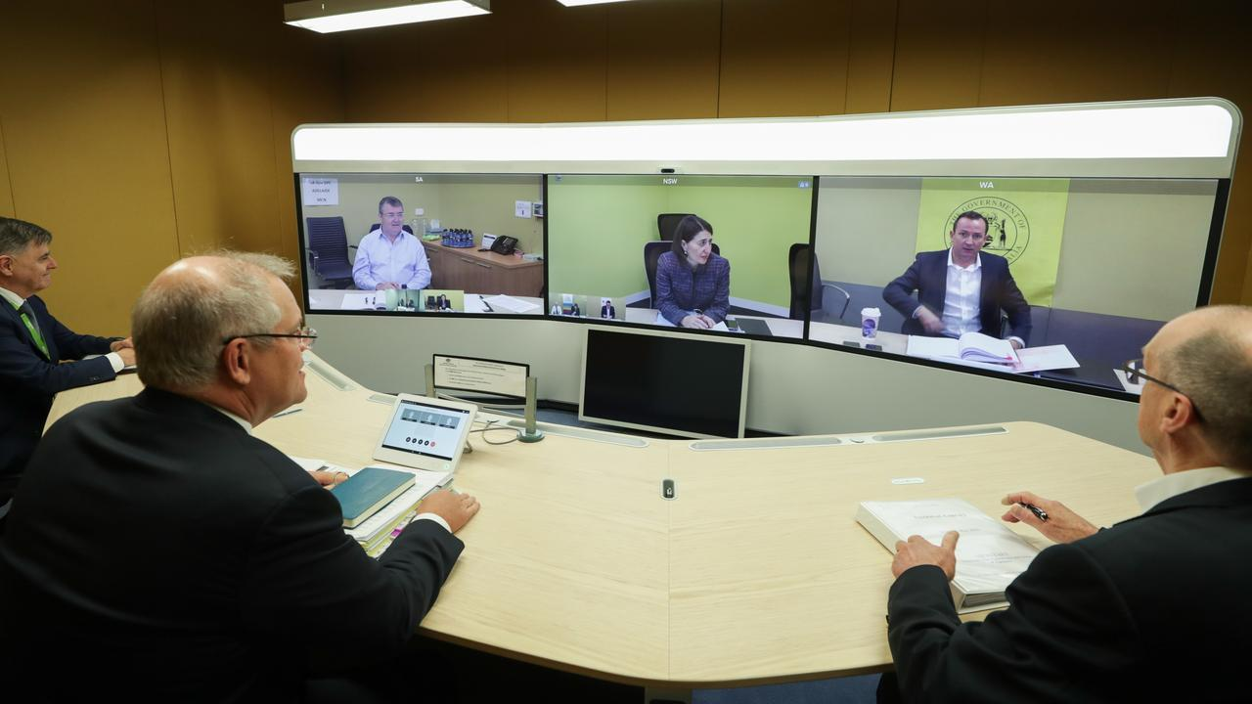

Slide 7
Unity in the Church (a joy for a Pastor to behold)
The same mind
The same love
In full accord
One mind
Doing nothing from selfish ambition or conceit
In humility, counting others as more significant than ourselves
1. Being of the same mind (Like-minded)
A unified belief in the truth of the Gospel of Jesus Christ
2. Having the same Love
Being a church who love Jesus and love each other
3. Being in full accord (one-souled / harmonious / united in Spirit)
When we are filled with the same Holy Spirit, we are in one accord
4. Being of one mind (about purpose) (being of one purpose)
To be Gospel-orientated in the way we relate to each other.
³ Do nothing from selfish ambition or conceit, but in humility count others more significant than yourselves.

Slide 8
Unity in the Church (a joy for a Pastor to behold)
1. Being of the same mind (Like-minded)
A unified belief in the truth of the Gospel of Jesus Christ
2. Having the same Love
Being a church who love Jesus and love each other
3. Being in full accord (one-souled / harmonious / united in Spirit)
When we are filled with the same Holy Spirit, we are in one accord
4. Being of one mind (about purpose) (being of one purpose)
To be Gospel-orientated in the way we relate to each other.
³ Do nothing from selfish ambition or conceit, but in humility count others more significant than yourselves. ⁴ Let each of you look not only to his own interests, but also to the interests of others.
Examples of reasons for Disunity
1. Counterfeit Unity
When we disagree on the fundamentals of the Gospel
2. When we follow men (instead of following Christ)
trying to be united in the vision of a leader
a problem in a consumer-based church (the church provides a service for me to consume)
Consumers of church largely have their own interests at heart (the destroyer of unity)

Slide 9
Unity in the Church (a joy for a Pastor to behold)
Examples of reasons for Disunity
1. Counterfeit Unity
When we disagree on the fundamentals of the Gospel
2. When we follow men (instead of following Christ)
trying to be united in the vision of a leader
a problem in a consumer-based church (the church provides a service for me to consume)
Consumers of church largely have their own interests at heart (the destroyer of unity)
3. We tend to put ourselves first
³ Do nothing from selfish ambition or conceit, but in humility count others more significant than yourselves. ⁴ Let each of you look not only to his own interests, but also to the interests of others. ⁵ Have this mind among yourselves, which is yours in Christ Jesus
We already have the mind of Jesus Christ. A renewal of our mind by the Holy Spirit in us

Slide 10
1. Being of the same mind (Like-minded)
A unified belief in the truth of the Gospel
2. Having the same Love
Being a church who love Jesus and love each other
3. Being in full accord (one-souled / harmonious / united in Spirit)
4. Being of one mind (about purpose)
Gospel-orientated in how we relate to each other.
⁵ Have this mind among yourselves, which is yours in Christ Jesus, ⁶ who, though he was in the form of God, did not count equality with God a thing to be grasped, ⁷ but emptied himself, by taking the form of a servant, being born in the likeness of men. ⁸ And being found in human form, he humbled himself by becoming obedient to the point of death, even death on a cross.
Jesus Christ is God (the Son). Not subordinate – just a different role
Emptied Himself. Took on the form of a servant. Lowered Himself. Jesus Christ died for us.
⁹ Therefore God has highly exalted him and bestowed on him the name that is above every name, ¹⁰ so that at the name of Jesus every knee should bow, in heaven and on earth and under the earth, ¹¹ and every tongue confess that Jesus Christ is Lord, to the glory of God the Father.
We who bow our knee before Jesus, are currently in the minority – Those who are saved
Christ-Likeness
As you and I become like Christ in humility and service, we see Godly Unity in the church

